Slide 1
Cluster Validation

Slide 2
Cluster Validity
For cluster analysis, the question is how to evaluate the “goodness” of the resulting clusters?
But “clusters are in the eye of the beholder”!
Then why do we want to evaluate them?
  To avoid finding patterns in noise
  To compare clustering algorithms
  To compare two sets of clusters
  To compare two clusters

Slide 3
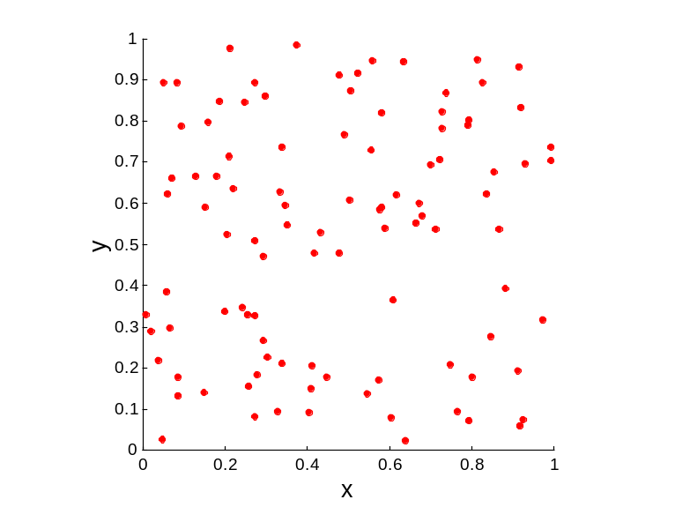
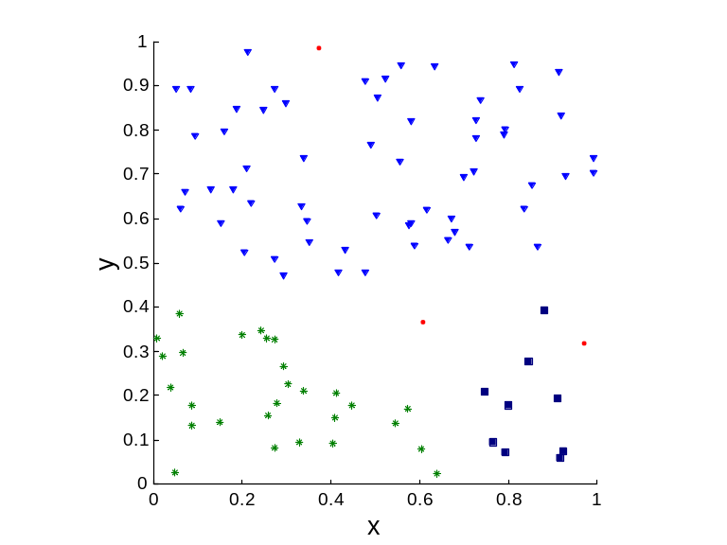
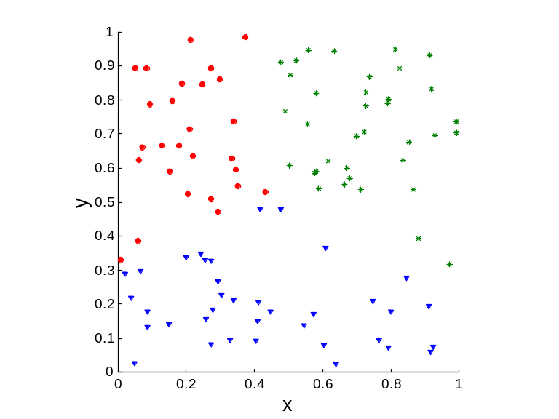
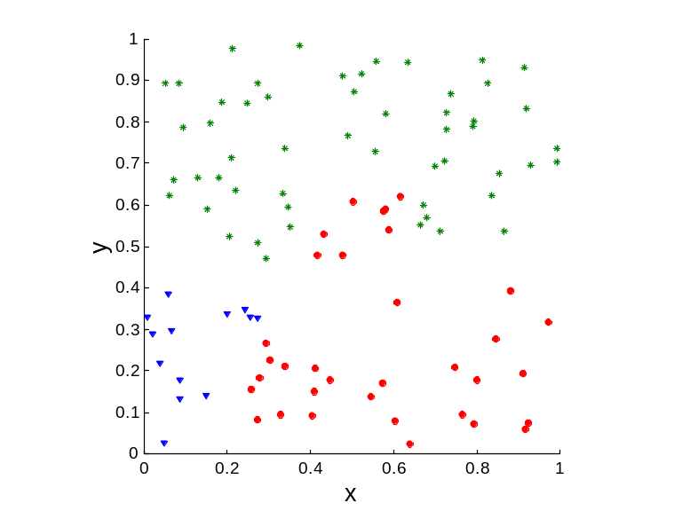
Clusters found in Random Data
Random Points
DBSCAN
K-means
Complete Link

Slide 4
Different Aspects of Cluster Validation
Determining the clustering tendency of a set of data, i.e., distinguishing whether non-random structure actually exists in the data.
Comparing the results of a cluster analysis to externally known results, e.g., to externally given class labels.
Evaluating how well the results of a cluster analysis fit the data without reference to external information.
  - Use only the data
Comparing the results of two different sets of cluster analyses to determine which is better.
Determining the ‘correct’ number of clusters.
For 2, 3, and 4, we can further distinguish whether we want to evaluate the entire clustering or just individual clusters.

Slide 5
Framework for Cluster Validity
Need a framework to interpret any measure.
  For example, if our measure of evaluation has the value, 10, is that good, fair, or poor?
Statistics provide a framework for cluster validity
  The more “atypical” a clustering result is, the more likely it represents valid structure in the data
  Can compare the values of an index that result from random data or clusterings to those of a clustering result.
    If the value of the index is unlikely, then the cluster results are valid
  These approaches are more complicated and harder to understand.
For comparing the results of two different sets of cluster analyses, a framework is less necessary.
  However, there is the question of whether the difference between two index values is significant

Slide 6
Measures of Cluster Validity
Numerical measures that are applied to judge various aspects of cluster validity, are classified into the following three types.
  External Index: Used to measure the extent to which cluster labels match externally supplied class labels.
    Entropy
  Internal Index: Used to measure the goodness of a clustering structure without respect to external information.
    Sum of Squared Error (SSE)
  Relative Index: Used to compare two different clusterings or clusters.
    Often an external or internal index is used for this function, e.g., SSE or entropy
Sometimes these are referred to as criteria instead of indices
  However, sometimes criterion is the general strategy and index is the numerical measure that implements the criterion.

Slide 7
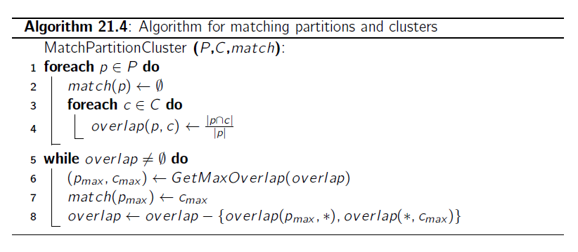
External Validation

Slide 8





Purity-Based Measure
Purity
Precision/Recall/F-Measure
prec(i,j), recall(i,j),
Entropy

Slide 9
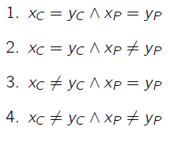


Matching Measure
Rand Statistic:
Jaccard Coefficient:

Slide 10


Correlation Measure
Hubert’s Tau Statistics:
Normalized Tau Statistics:

Slide 11
Measuring Cluster Validity Via Correlation
Two matrices
  Proximity Matrix
  “Incidence” Matrix
    One row and one column for each data point
    An entry is 1 if the associated pair of points belong to the same cluster
    An entry is 0 if the associated pair of points belongs to different clusters
Compute the correlation between the two matrices
  Since the matrices are symmetric, only the correlation between
  n(n-1) / 2 entries needs to be calculated.
High correlation indicates that points that belong to the same cluster are close to each other.
Not a good measure for some density or contiguity based clusters.

Slide 12
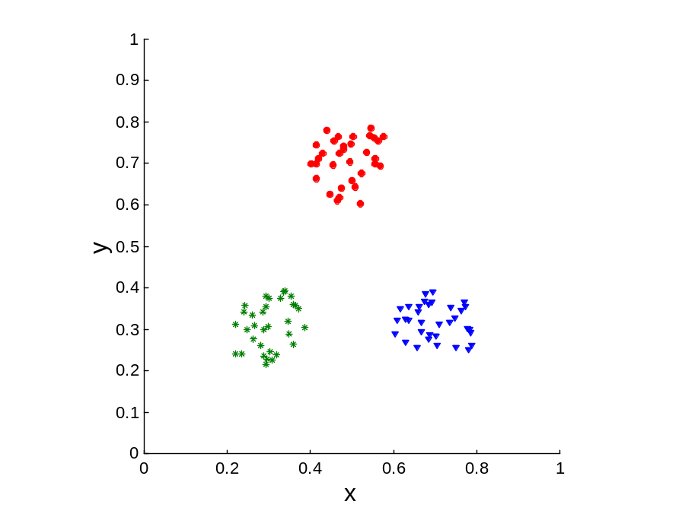
Measuring Cluster Validity Via Correlation
Correlation of incidence and proximity matrices for the K-means clusterings of the following two data sets.
Corr = -0.9235
Corr = -0.5810

Slide 13
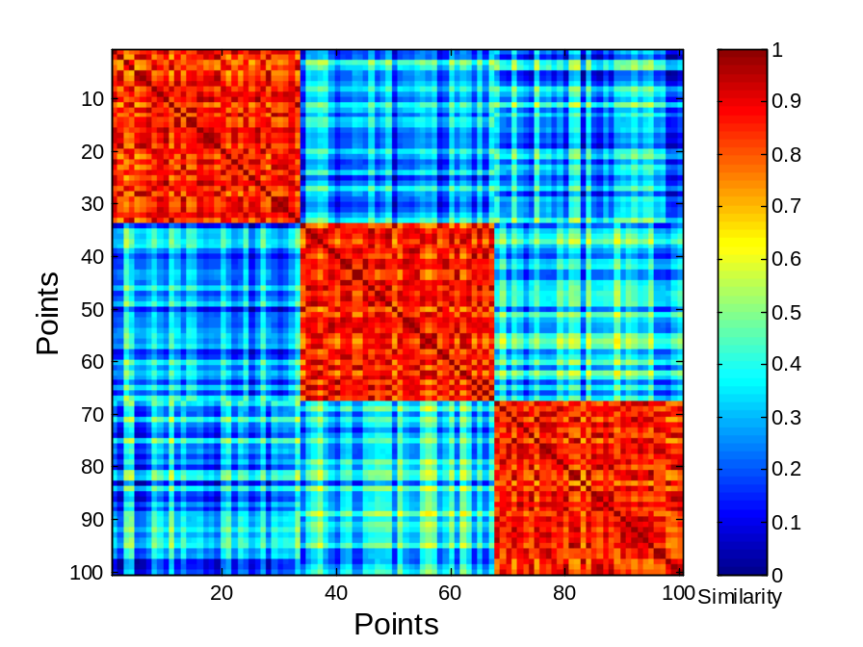
Using Similarity Matrix for Cluster Validation
Order the similarity matrix with respect to cluster labels and inspect visually.

Slide 14
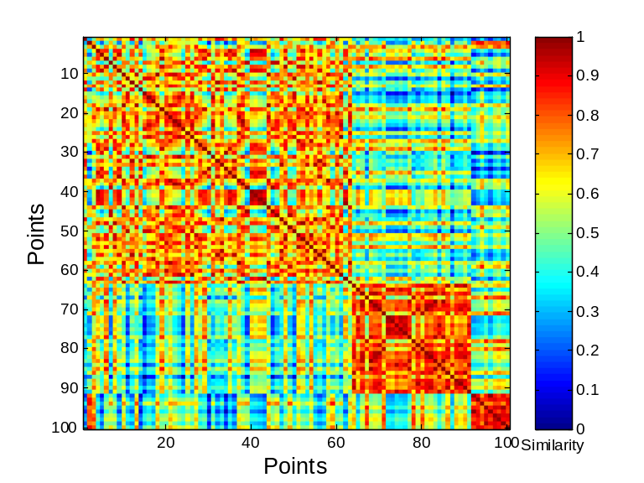
Using Similarity Matrix for Cluster Validation
Clusters in random data are not so crisp
DBSCAN

Slide 15
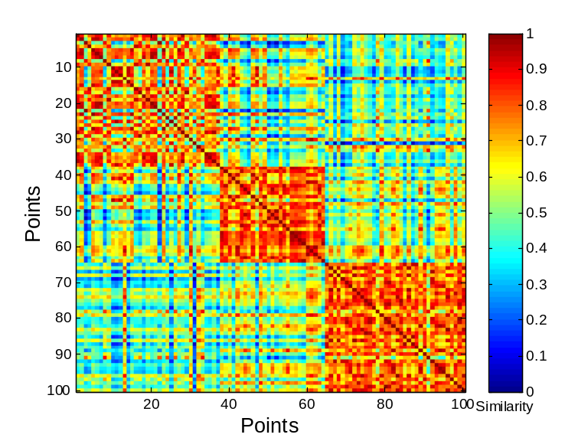
Using Similarity Matrix for Cluster Validation
Clusters in random data are not so crisp
K-means

Slide 16
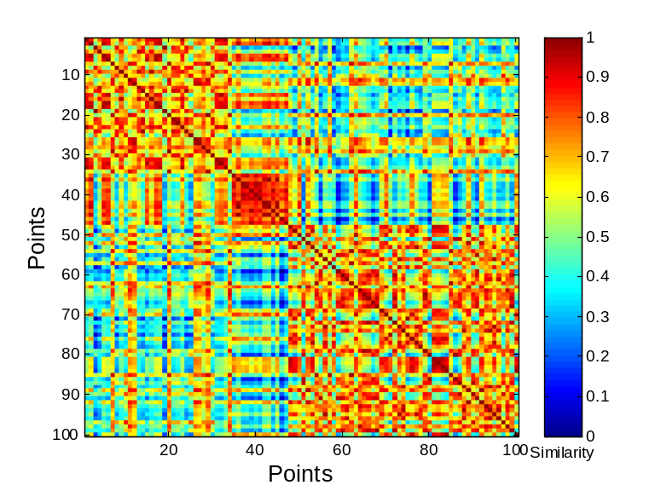
Using Similarity Matrix for Cluster Validation
Clusters in random data are not so crisp
Complete Link

Slide 17
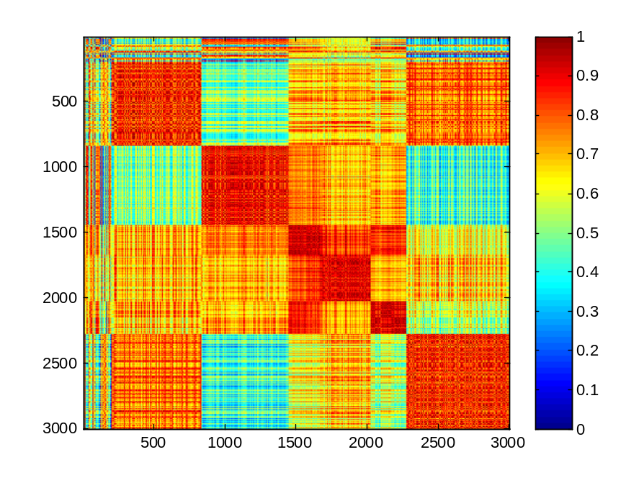
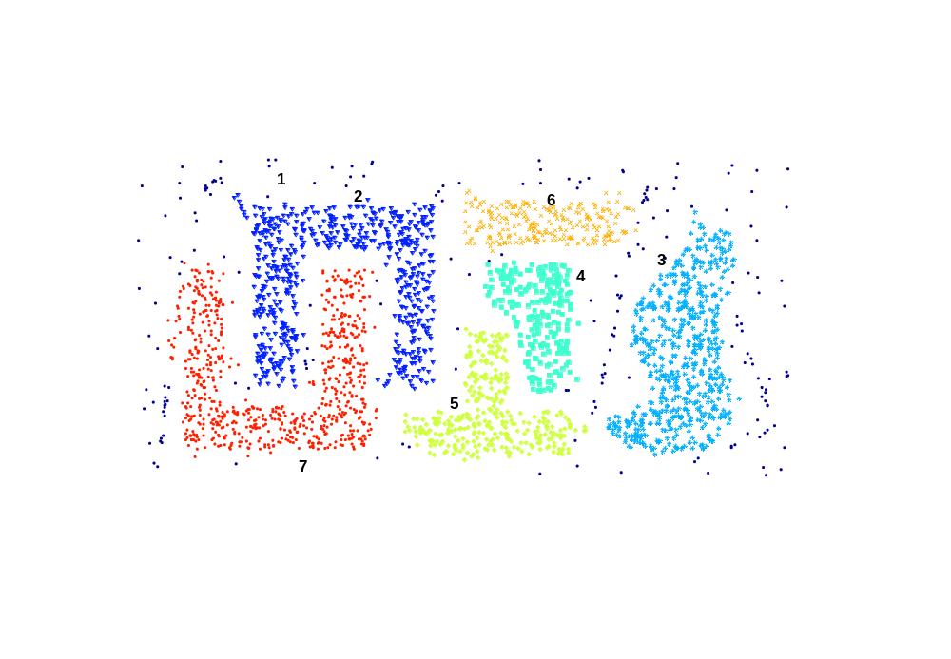
Using Similarity Matrix for Cluster Validation
DBSCAN

Slide 18
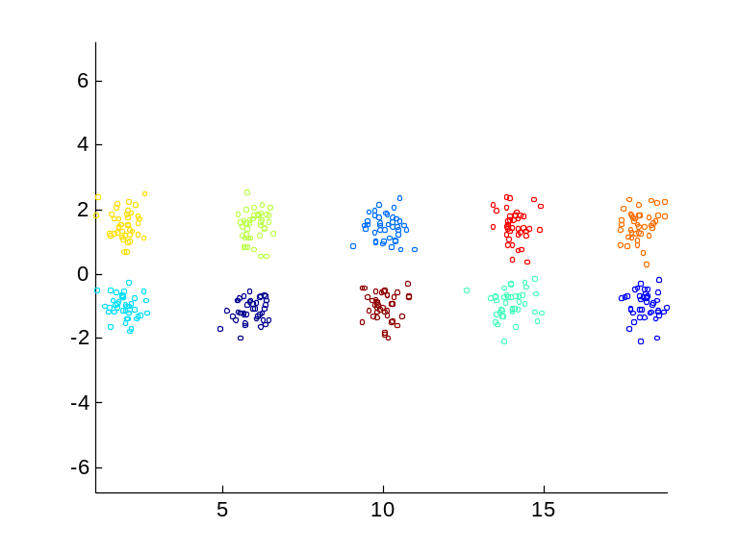
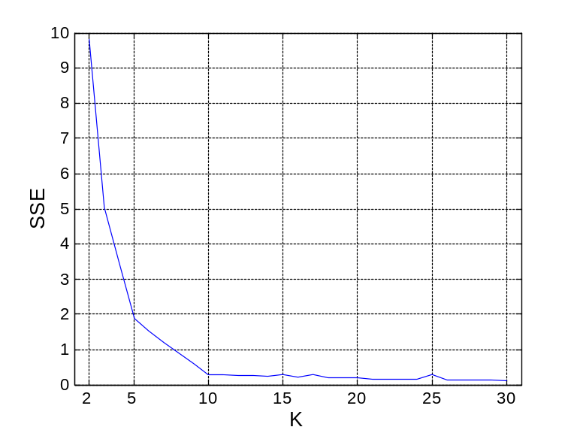
Internal Measures: SSE
Clusters in more complicated figures aren’t well separated
Internal Index: Used to measure the goodness of a clustering structure without respect to external information
  SSE
SSE is good for comparing two clusterings or two clusters (average SSE).
Can also be used to estimate the number of clusters

Slide 19
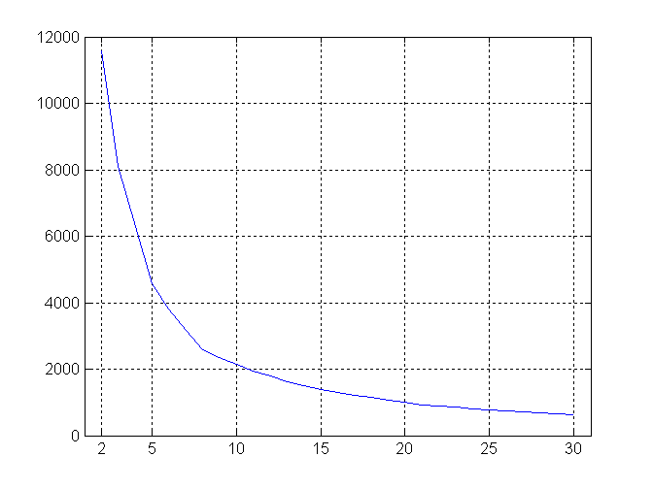
Internal Measures: SSE
SSE curve for a more complicated data set
SSE of clusters found using K-means

Slide 20
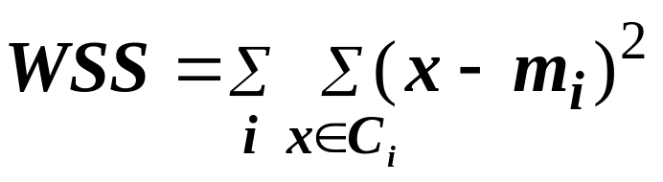
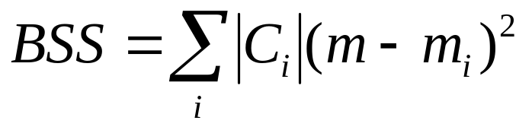
Internal Measures: Cohesion and Separation
Cluster Cohesion: Measures how closely related are objects in a cluster
  Example: SSE
Cluster Separation: Measure how distinct or well-separated a cluster is from other clusters
Example: Squared Error
  Cohesion is measured by the within cluster sum of squares (SSE)
  Separation is measured by the between cluster sum of squares
      Where |C_{i}| is the size of cluster i

Slide 21
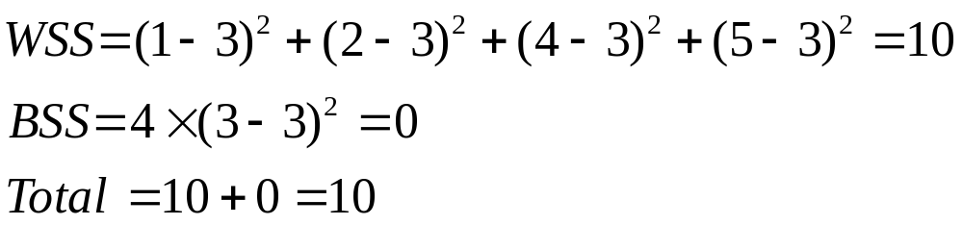
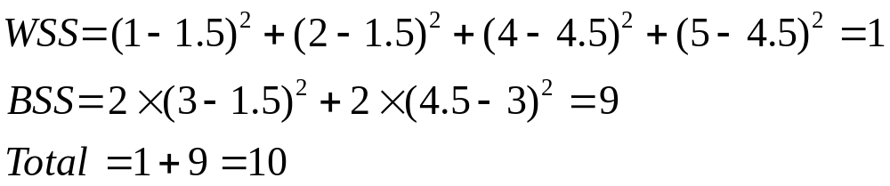
Internal Measures: Cohesion and Separation
Example: SSE
  BSS + WSS = constant
m
×
×
×
1
m₁
2
3
4
m₂
5
K=1 cluster:
K=2 clusters:

Slide 22
Internal Measures: Cohesion and Separation
A proximity graph based approach can also be used for cohesion and separation.
  Cluster cohesion is the sum of the weight of all links within a cluster.
  Cluster separation is the sum of the weights between nodes in the cluster and nodes outside the cluster.
cohesion
separation

Slide 23
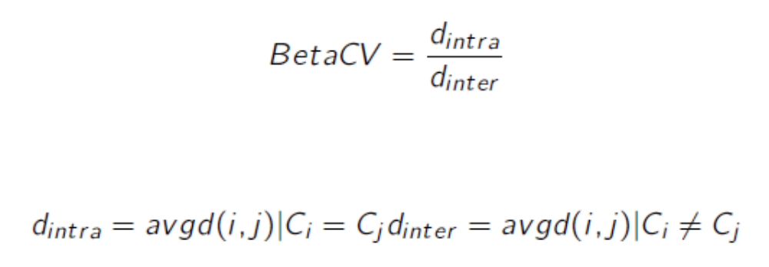
BetaCV

Slide 24
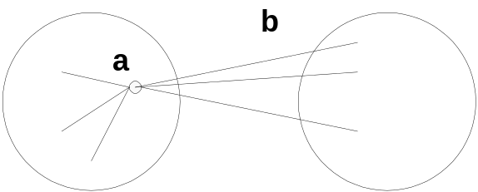
Internal Measures: Silhouette Coefficient
Silhouette Coefficient combine ideas of both cohesion and separation, but for individual points, as well as clusters and clusterings
For an individual point, i
  Calculate a = average distance of i to the points in its cluster
  Calculate b = min (average distance of i to points in another cluster)
  The silhouette coefficient for a point is then given by
  s = 1 – a/b if a < b, (or s = b/a - 1 if a ≥ b, not the usual case)
  Typically between 0 and 1.
  The closer to 1 the better.
Can calculate the Average Silhouette width for a cluster or a clustering

Slide 25
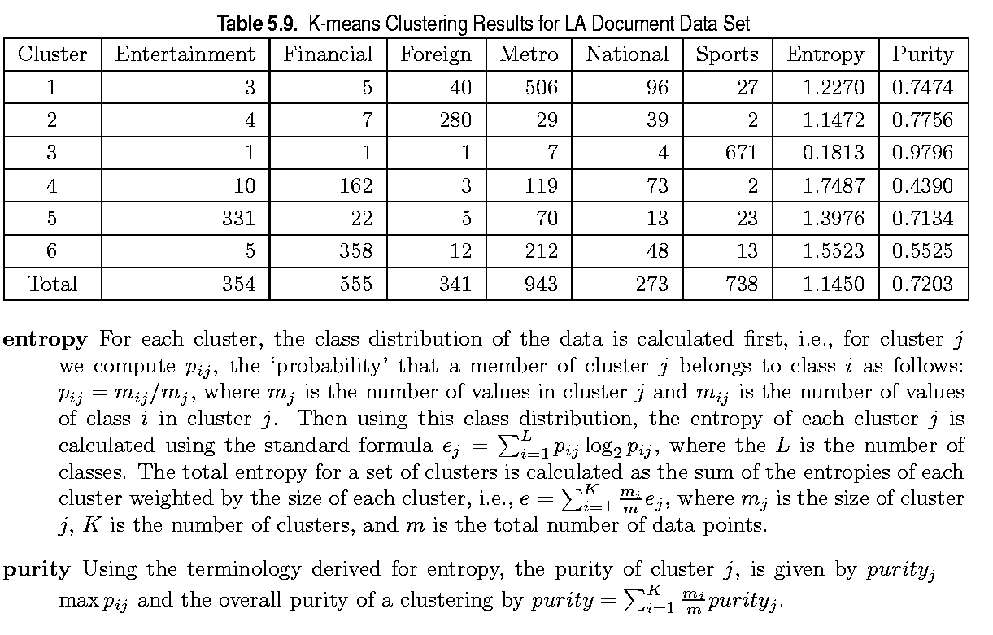
External Measures of Cluster Validity: Entropy and Purity

Slide 26
Final Comment on Cluster Validity
“The validation of clustering structures is the most difficult and frustrating part of cluster analysis.
Without a strong effort in this direction, cluster analysis will remain a black art accessible only to those true believers who have experience and great courage.”
Algorithms for Clustering Data, Jain and Dubes

Slide 27
Extra Slides

Slide 28
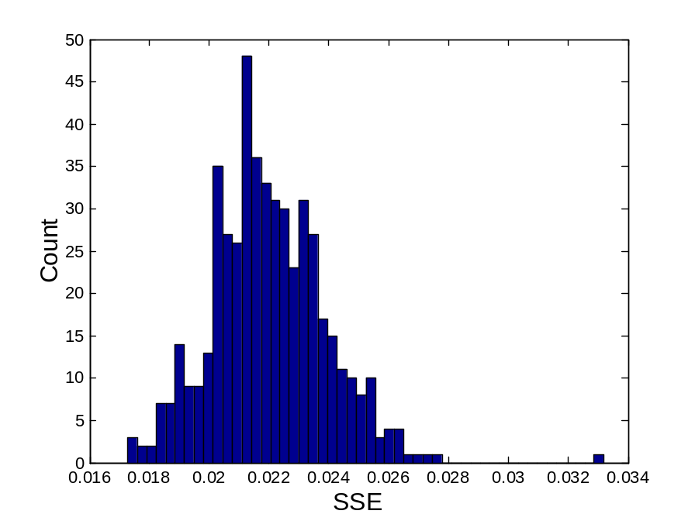
Statistical Framework for SSE
Example
  Compare SSE of 0.005 against three clusters in random data
  Histogram shows SSE of three clusters in 500 sets of random data points of size 100 distributed over the range 0.2 – 0.8 for x and y values

Slide 29
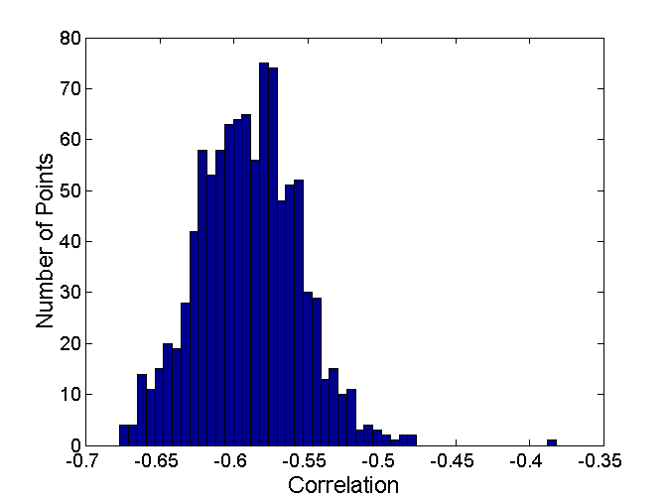
Statistical Framework for Correlation
Correlation of incidence and proximity matrices for the K-means clusterings of the following two data sets.
Corr = -0.9235
Corr = -0.5810

